Slide 1
Jira Agile Tips and Tricks 2 https://github.com/bobk/jirapresentations
meetup.com - Princeton Lean Coffee Agile Meetup
Online Lean/Agile Lightning Talk – Sep 30, 2020
Bob Kozlowski - http://www.robertkozlowski.com
versatile experienced Azure/Jira/Windows/SDLC/DevOps engineer
25 years global FinServ IT experience - Azure, Windows, CSM, Qualys, ITIL certs
available Nov 2020 for next contracting/advisory role

Slide 2
This Time
A Simple Jira Command Line in Python
Jira Book Review

Slide 3
Does Jira Have a Command Line?
For end-users? - Yes and No – not in the box
SEVERAL OPTIONS
Bob Swift Apps:
https://marketplace.atlassian.com/apps/6398
Not free, not open source
Very powerful
Requires server plug-in and client download
JIRA CLI
https://docs.jiracli.com
Free, open-source
Requires node.js, which can be difficult to manage at times
Good functionality
Several others available via Google search

Slide 4
Why another one?
To show how simple it can be
Requires only Python + two easily “pip install”-able modules
https://github.com/bobk/jiracl
Less than 150 lines
Easily customizable to your needs
Supports command files
Using this, Jira automation can be added to centralized CI/CD tools that don’t yet have full support for it, or to your own local IDE build scripts
Sweet-spot: anything you want to do locally that is 90% bringing up a GUI + finding an issue and 10% changing a field
Create a issue with basic fields
Change an issue assignee
Update an issue description
Change an issue status
Quick demo

Slide 5
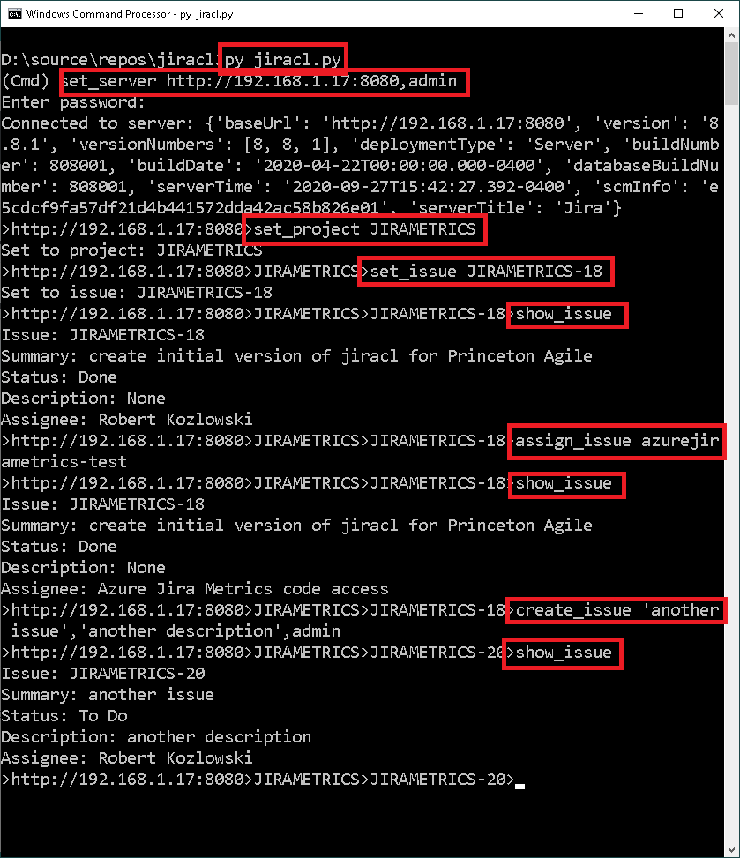
Demo

Slide 6
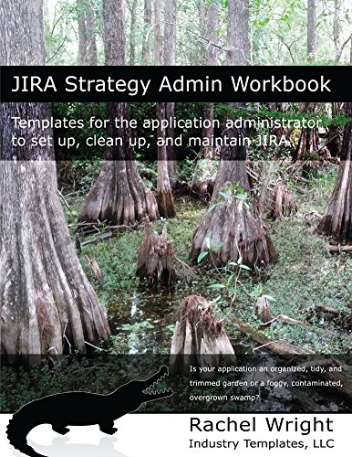
Jira Book Review
Some Jira books are rehashes of the user docs, some deal with older Jira versions, some are just rather light technically
This is my most-used Jira book
Jira Strategy Admin Workbook - Rachel Wright
https://www.amazon.com/JIRA-Strategy-Admin-Workbook-administrator-ebook/dp/B07D7JMYHC
Contains good templates for each critical decision process within Jira (initial setup, new projects, new fields, etc.)
A lot of good information about practical impacts of making certain setup and configuration choices, as well as information on the technical debt that can accumulate in poorly- or non-managed Jira instances over time
If you are someone who has Jira instance maintenance in their job description, under “other duties as assigned”, this book may help

Slide 7
Next Time?
Simple Jira Agile Metrics via Python and SQL (and Azure)
Jira Epic Thoughts and Jira Agile Tips and Tricks 1
Git Integration Options for Jira
Jira Agile Tips and Tricks 2/Command Line/Book Review
Jira Issue Collectors and what to use them for
Jira Agile Tips and Tricks 3

Slide 8
Questions/Feedback?
Thank You!
Robert Kozlowski
http://www.robertkozlowski.com

